Slide 1
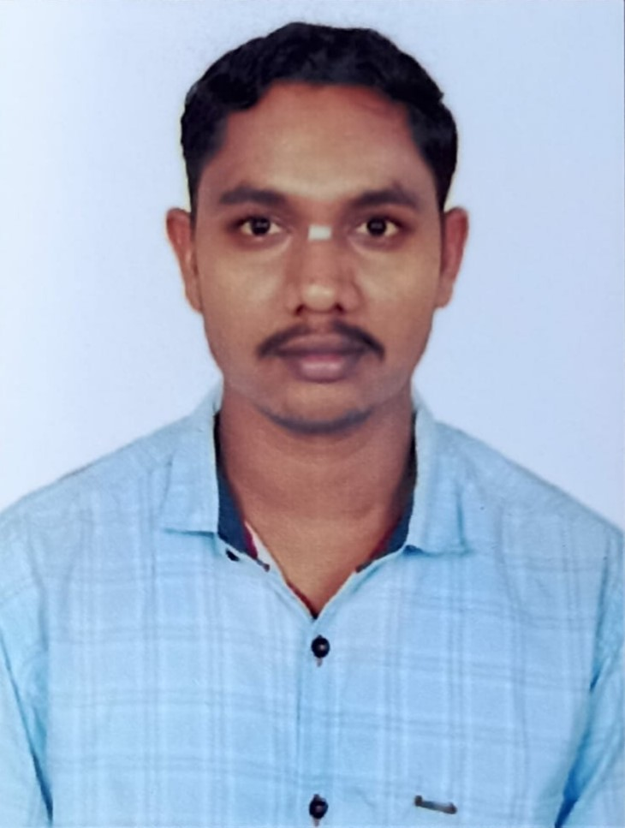
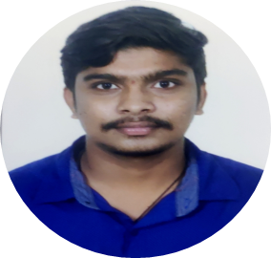

RAJU HANAMANNAVAR
Analyst/Software Engineer
BACHELOR OF ENGINEERING
Mechanical Engineering:2018-2021
Skills
C
C#
Dot net core
Azure
Database
MS SQL Server 2019
SQL core
Web Technologies
HTML5
CSS3
AddOns
Github
Additional skills
Leadership Qualities
Quick Learner
Team Management
Good communication
BANGALORE
raju.hanamannavar@capgemini.com
+91 9071235286
A4
Well versed with the functional knowledge of SDLC stages ranging from Requirement Gathering to Analysis, Design, Development, Testing, Deployment and Documentation.
A team player with good communication skill always ready to work for the enrichment of knowledge. Able to adopt the process changes effectively.
Ability and flexibility to multi-task, prioritize, and organize multiple projects/ tasks concurrently while meeting project deadlines.
Have better understanding on process agility and can come to up to speed on new technologies/ methodologies in best possible way.
Able to deliver with zero defects products to customer with good development skills and interact with client with excellent communication skills.
Laundry Management System :
Completed end to end case study of Laundry management System along with postman, html, CSS.
Microsoft Azure Fundementals Certificate :
Completed this course with 80%.
AZ-900&AZ-104 Certifications
Experience
worked as a shadow resource in Owence Corning project(April 18th to Aug 15th)
Monitoring the logic apps and Apis.
Role: Support role

